Slide 1
EYFS Curriculum
Cliffe V.C. Primary School
2021 - 2022

Slide 2
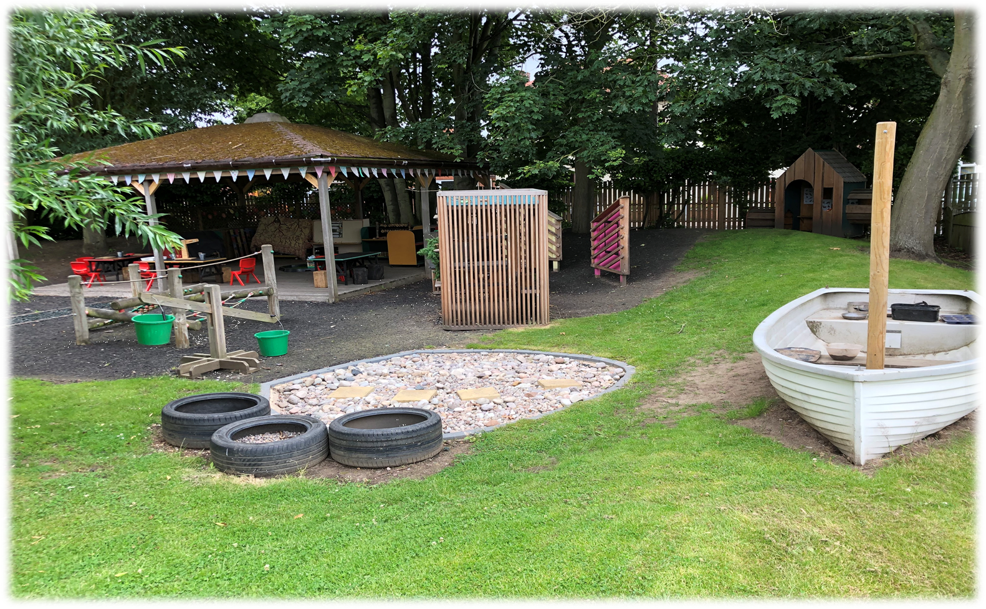
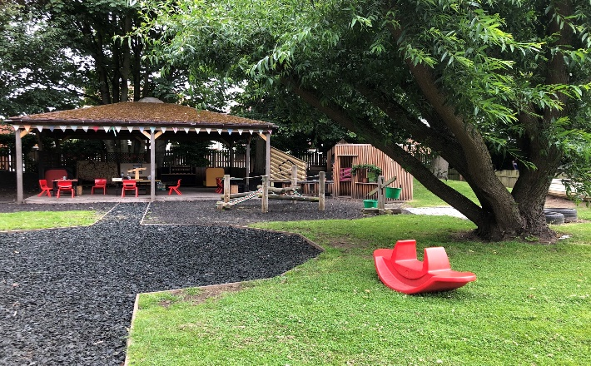
Our Class
In Reception and Year One, we provide high-quality EYFS education, giving children a secure and confident start to their school life. We are committed to nurturing a lifelong love of learning, alongside the aims of the EYFS Statutory Framework. We strive for high standards, consider the development of the whole child and seek to foster resilience and independence. We are inclusive and welcoming to all and British values are embedded into all that we do. We aim to provide the essential knowledge that children need to prepare them for their future success and to give children the best possible start to their early education. To do this we plan our curriculum so that it can:
Broaden minds and children’s outlook on life
Provide experience of awe and wonder
Reduce disadvantage
Consider children’s backgrounds and experiences
Develop knowledge and understanding of the community and wider world
Staffing and Organisation
At Cliffe VC Primary School, we have a mixed Reception and Year One class that has the use of two classrooms and a large dedicated outdoor area. The classroom has a variety of free choice provision and areas for the children to access (including the Year One children).
Staff are organised to support the children in a balance of adult-led and child-initiated experiences throughout the day, and as much as possible, the EYFS have free flow access to the outdoor learning and provision.
Our experienced team plan a variety of exciting learning opportunities each day as well as responding to unplanned themes and topics that interest the children.

Slide 3
How do we teach children in Reception? In our classroom, you may see children playing alone or with their peers, deciding on resources and choosing how to spend their time. You may see a child playing and listening to an adult, who is modelling how to achieve something or teaching a new skill that interests the child. Adults may scaffold a children’s play. This involves taking their play to higher levels of learning, entering the play as a co-creator and helping to provoke a framework for the children to go from “what they know” to “what else they could know”! Scaffolding enables a child to solve a problem, carry on a task or achieve a goal which is just beyond his or her abilities. During play, where foundational social and emotional skills are developed, scaffolding is a bridge to new skills levels using three key ingredients; modelling the skills, giving clues and asking questions while the child is trying out a new skill, and then the child approaches mastery, withdrawing the support.
Play, Scaffolding, Modelling & Directed Teaching
The new statutory framework does not prescribe a particular teaching approach. The DfE (2021) state in the framework (p16) that “Play is essential for children’s development, building their confidence as they learn to explore, related to others, set their own goals and solve problems. Children learn by leading their own play, and by taking part in play which is guided by adults.”
In our school, we decide on overarching themes linked to what we want our children to learn in our classroom, through our provision, and the most effective ways to teach it. Each day, we stimulate children’s interests, respond to each child’s emerging needs and guide their development through warm, positive interactions coupled with secure routines for play and learning. As children grow older and develop their skills throughout the reception year, we use more direct teaching and modelling and plan specific sequences of lessons. These strategies help us to focus on teaching the essential skills and knowledge in specific areas of learning so that children develop the skills and confidence required for the end of their Reception Year.

Slide 4
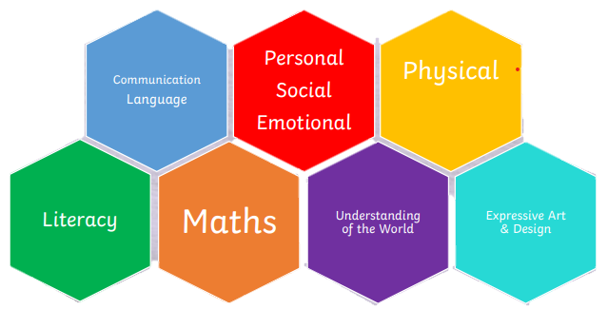
The Statutory EYFS Framework
The Early Learning Goals (ELGs) are the knowledge, skills and understanding which young children should have acquired by the end of their Reception year.
There are three prime areas of learning
Communication and Language Development
Personal, Social and Emotional Development
Physical Development
There are four core areas of learning:
Literacy
Maths
Understanding of the World
Expressive Arts and Design
In addition, the ‘Characteristics of Effective Learning’ underpin learning and development across all areas and support the child to remain an effective and motivated learner.
The Characteristics of Effective Learning are:
Playing and exploring – engagement
Active learning – motivation
Creating and thinking critically – thinking

Slide 5
Planning in the EYFS
Our planning focuses on the children’s needs, their interests and their stages of development. We seek opportunities to make links between the areas of learning and use them to plan in next steps accordingly.
As our class is a mixed-age class, then we often use themes or topics that link in with the Year One curriculum. This planning successfully embeds the EYFS curriculum in an exciting and age-appropriate way whilst giving the EYFS children a taste of some foundation subjects before they transition into Year One.
We deliver the curriculum through planned, purposeful play as well as adult-directed learning to enable the children build on what already know. In class, the children may be taught as a whole class, in their year groups, in small groups or individuals to ensure that all children are progressing from their own individual starting point.
Effective Teaching and Learning
We encourage the children to guide us in shaping their learning experiences. We discuss with the children what they are interested in and which skills they would like to develop further. Children are encouraged to bring books and resources that interest them into school to share with their peers, or add things into their home/school journal. Alongside completing an ‘all about me’ booklet with their child at the beginning of the year, we also encourage parents to contribute their own observations on Seesaw to learn more about each child’s likes and dislikes. We develop children’s curiosity and hunger for learning, and find ways to answer the children’s many questions!
We provide a challenging, exciting and attractive learning environment that offers high quality opportunities for the children to learn through play within the classroom and outside. Our classroom has continuous provision that is designed to offer practical, open-ended learning opportunities where children are enabled to think creatively and imaginatively. The children are supported to explore how resources can be adapted and use their skills in a variety of contexts. We develop problem-solving skills through open-ended tasks and encourage children to share their thinking with others.

Slide 6
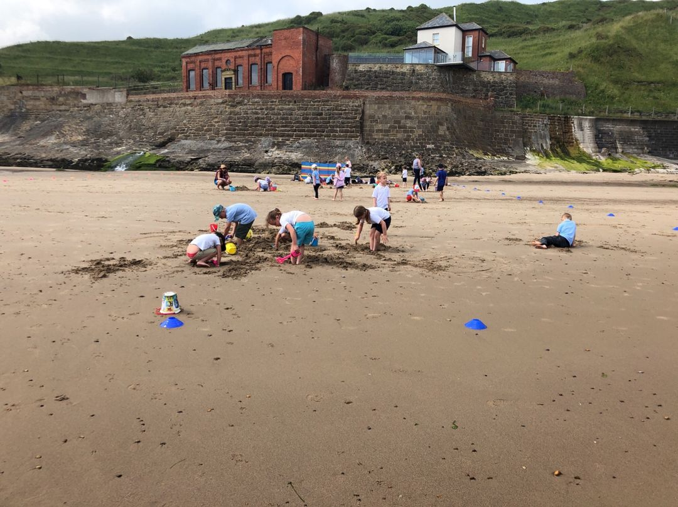
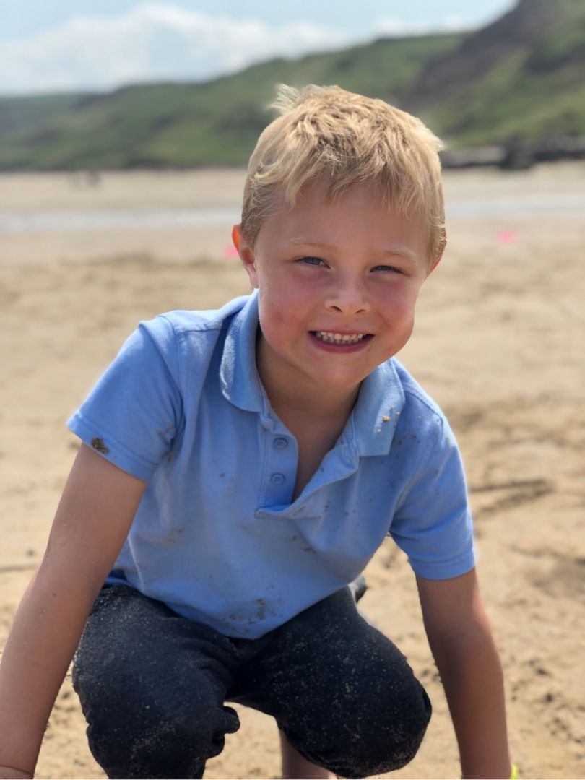
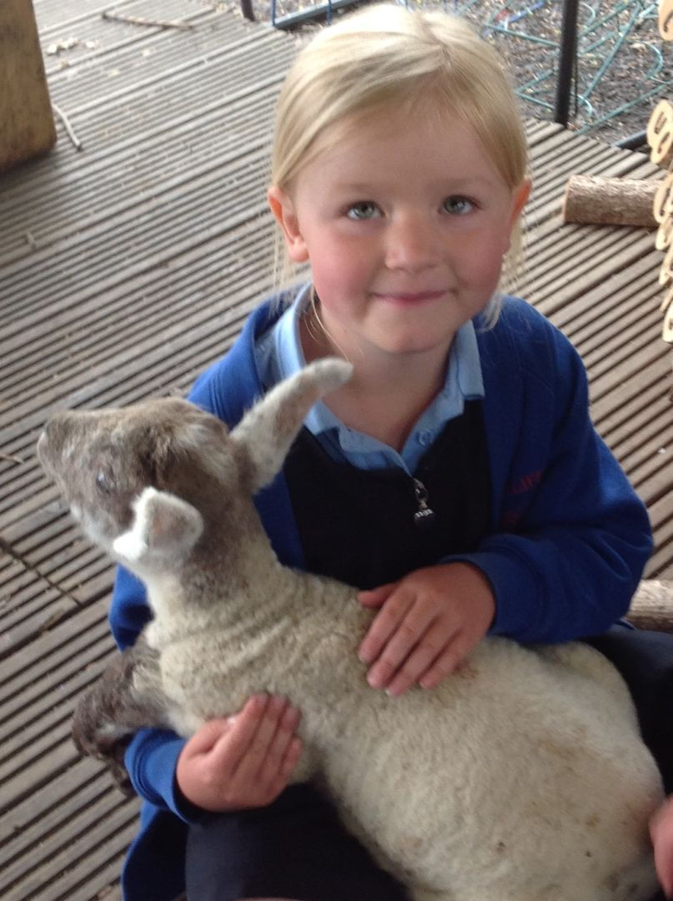
Personal Development
Personal Development
To support children’s skills in the prime areas of PSED, we aim to promote an understanding of people, different cultures and communities beyond their own. Through Learning for Life lessons and learning opportunities, we teach the language of feelings to develop emotional literacy and support emotional security through regular circle time sessions, discussions, modelled behaviour and provision of a safe learning environment.
By focusing on the characteristics of effective learning, we strive to promote resilience, motivation and appropriate risk taking and problem solving. This supports the child’s independence and build on key skills that they will need throughout their life.
In our school, we teach children about how to keep themselves healthy through good hygiene, healthy eating, exercise and being kind to others. Children are taught about how to keep themselves safe online, in the home, and how to behave around things that may be harmful to their health. We have visitors from the community such as: the fire brigade, a dentist etc.

Slide 7
Communication & Language
Read and reread selected texts • Daily story time
Model words and phrases • Model talk routines
Ask open questions • Identify new vocabulary
Promote active listening skills
Signal when we want children to listen
Link listening with learning
Repeat vocabulary regularly and revisit
Provide a large selection of objects, photos and pictures to talk about
Think out loud, ask questions to check understanding; make sure children can answer who, where and when questions before moving into why and ‘how do you know’ questions
Show genuine interest in knowing more
Provide traditional and modern books
Use complete sentences in everyday talk. Help children build sentences using new vocabulary by rephrasing what they say and structuring their responses where appropriate
Narrate your own and children’s actions
Remind of past events • Repeat and revisit vocabulary
Make deliberate mistakes to highlight we can be wrong!
Take on different roles in imaginative play, to interact and negotiate with people in longer conversations
Think out loud, support to solve problems, use problem solving words & phrases
Communication and Language
ELG: Listening, Attention and Understanding
Children at the expected level of development will:
Listen attentively and respond to what they hear with relevant questions, comments and actions when being read to and during whole class discussions and small group interactions;
Make comments about what they have hears and ask questions to clarify their understanding;
Hold conversation when engaged in back-and-forth exchanges with adults and peers.
ELG: Speaking
Children at the expected level of development will:
Participate in small group, class and one-to-one discussions, offering their own ideas, using recently introduced vocabulary;
Offer explanations for why things might happen, making use of recently introduced vocabulary from stories, non-fiction, rhymes and poems, when appropriate.
Express their ideas and feelings about their experiences using full sentences, including use of past, present and future tenses and making use of conjunctions, with modelling and support from their teacher.

Slide 8
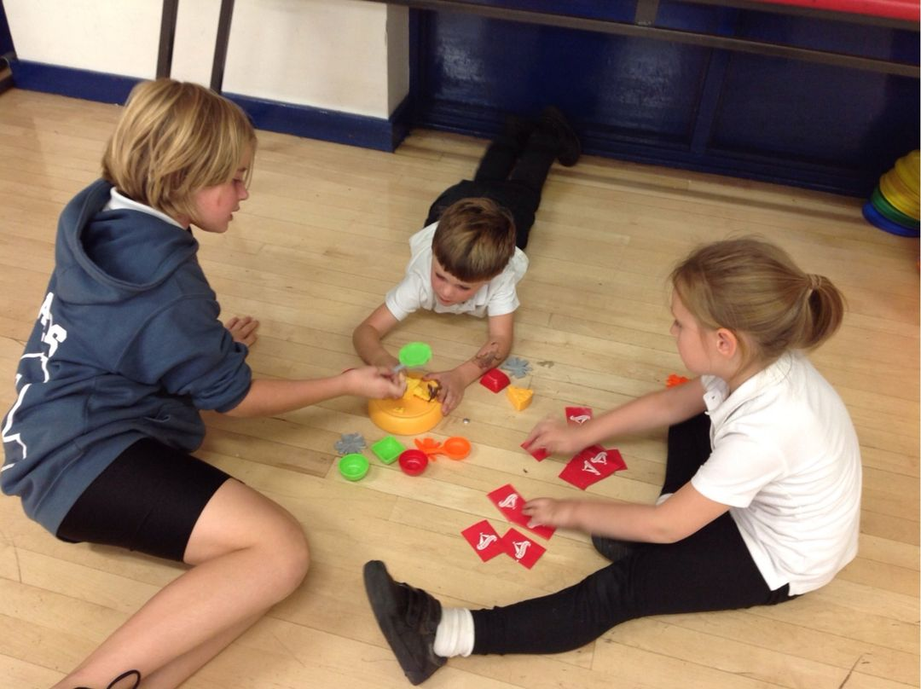
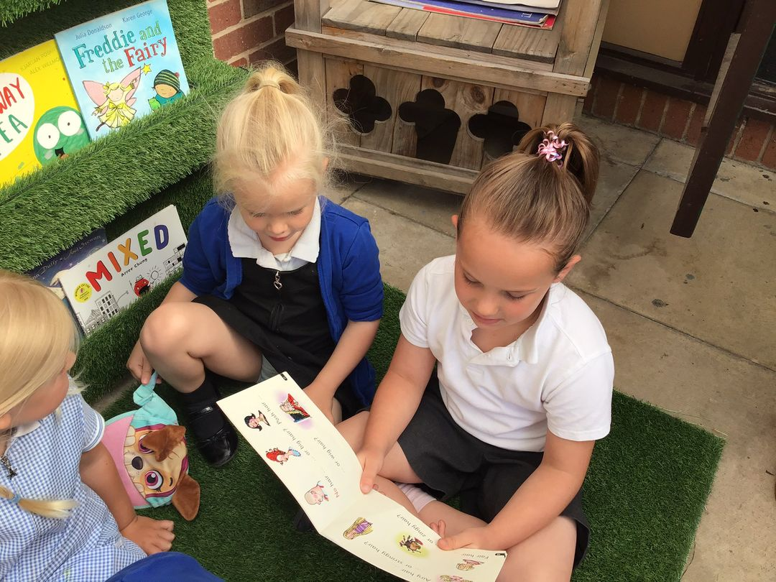
Communication & Language
Quality fiction and non-fiction texts for focused learning and story time
Adult modelling, questioning and conversation
Carpet time sessions
Daily storytime and rereading of texts
Show & Tell/ Learning talk (sharing learning experiences from the day
Vocabulary displayed in classroom and revisited
Observed interaction with peers
Scaffolded play and conversation with adults
Nursery rhymes and songs to develop vocabulary and extend learning
Daily class songs in routine
Use of ‘tell me more’ to encourage conversation
‘Snack time, chat time’
Year 6 buddies- reading, playing games and chat time
What does it look like at Cliffe VC Primary School?

Slide 9
Personal, Social and Emotional
Encourage children to express their feelings if they feel hurt or upset using descriptive vocabulary
Make time to get to know the child and their family
Ask parent’s about the child’s history, likes, dislikes, family members and culture
Highlight children’s interests • Model practises that support good hygiene
Encourage cooperation, sharing and kindness
Narrating your own decisions about healthy foods
Encourage listening to peers as well as adults
Express your approval when they help, listen and support each other
Allow time in friendship groups as well as other groupings
Help children to set goals and achieve them
Have high expectations for children following instructions
Model positive behaviour and highlight exemplary behaviour
Undertake specific activities that encourage talk about feelings and their opinions
Offer constructive support and recognition of a child’s personal achievements
Provide opportunities for children to tell each other about their work and play
Help them reflect and self evaluate their own work
Encourage them to think about their own feelings and those of others by giving explicit examples of how others might feel
Give children space to calm down and return to an activity
Use dialogic story time (talking about ideas arising from a story whilst reading aloud) to discuss books that deal with challenges
Ask children to explain to others what they thought about a problem or an emotion and how they deal with it
Personal, Social & Emotional
ELG: Self- Regulation
Children at the expected level of development will:
Show an understanding of their own feelings and those of others, and begin to regulate their behaviour accordingly;
Set and work towards simple goals, being able to wait for what they want and control their immediate impulses when appropriate;
Give focused attention to what the teacher says, responding appropriately even when engaged in an activity, and show an ability to follow instructions involving several ideas or actions..
ELG: Managing Self
Children at the expected level of development will:
Be confident to try new activities and show independence, resilience and perseverance in the face of challenge;
Explain the reasons for rules, know right from wrong and try to behave accordingly;
Manage their own basic hygiene and personal needs, including dressing, going to the toilet and understanding the importance of healthy food choices.
ELG: Building Relationships
Children at the expected level of development will:
Work and play cooperatively and take turns with others;
Form positive attachments to adults and friendships with peers;
Show sensitivity to their own and others’ needs.

Slide 10
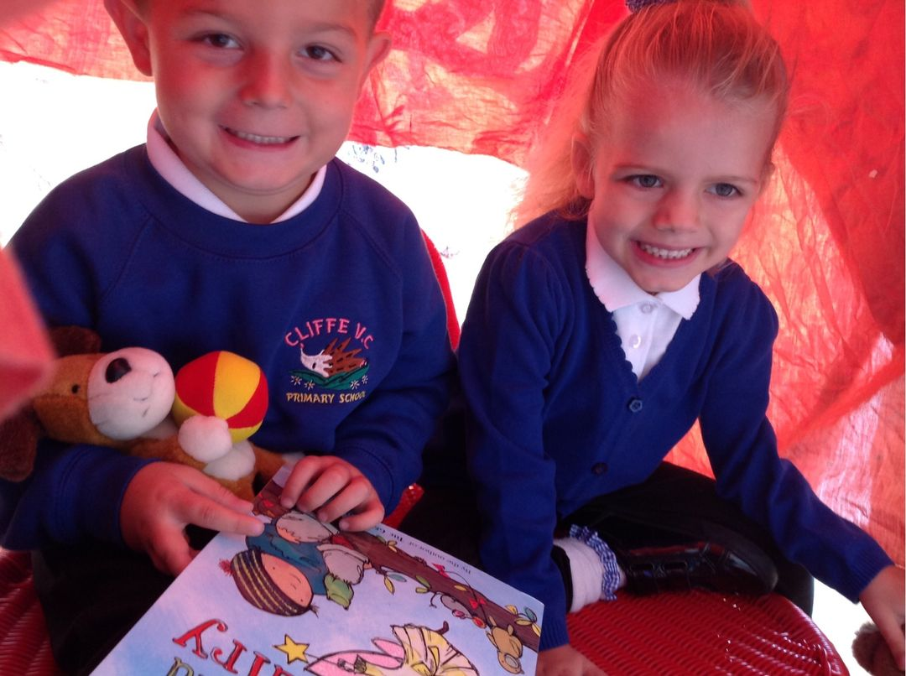
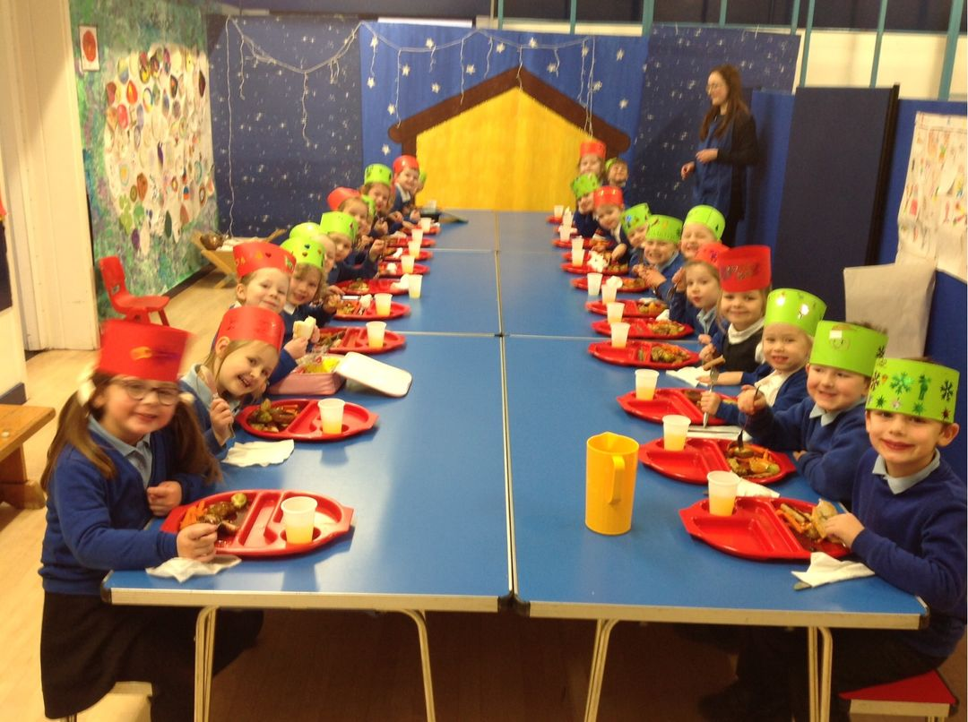
Personal, Social and Emotional
Children discuss and decide on our classroom rules at the beginning of the year, then record and display in the classroom for reference
Daily modelling of school rules
Clear routines, following school behaviour policy
Positive reinforcement of expected behaviour
Circle time and scaffolded social interactions to support friendship issues
Parental involvement: Amazing me! Booklet, Seesaw, discussions about children interested ensure that we get to know the child and their interests
Specific lessons on healthy eating, being healthy, staying safe, managing emotions, understanding feelings, dealing with frustration or adversity
Celebration assembly
Constructive feedback
Children’s voice in the classroom; writing space to record requests for colouring pages, regular book votes to decide on storytime texts
Good quality texts and resources to support teaching
Use of puppets, songs, stories and videos to model feelings, emotions and problems, and show how we deal with them
Observations of children’s interactions and social skills
Calm down basket/ quiet space for children who need it
What does it look like at Cliffe VC Primary School?

Slide 11
Physical- Gross Motor
Provide regular access to outdoor space
Encourage children to be highly active and get out of breath several times every day
Provide a choice of open-ended materials to play with, that allow for extended, repeated and regular practising of physical skills like lifting, carrying, pushing, pulling, constructing, stacking and climbing
Provide a wide range of activities to support a broad range of abilities
Ensure that spaces are accessible to children with varying confidence levels, skills and needs
Model precise vocabulary to describe movement and directionality, and encourage children to use it
Challenge children with further physical challenges when they are ready, such as climbing higher, running faster and jumping further
Provide areas for sitting at a table that are quiet, purposeful and free of distraction. Give children regular, sensitive reminders about correct posture
Provide opportunities to move that require quick changes of speed and direction
Create obstacle courses that demand a range of movements to complete, such as crawling through a tunnel, climbing on a chair, jumping in a hoop and running then lying on a cushion
Provide a range of balls and model games
Encourage precision and accuracy when beginning and ending movements
Encourage children to use a range of equipment. These might include wheeled toys, wheelbarrow, tumbling mats, ropes to pull up on, tunnels, tyres, structures to jump on/off, den-making materials, logs and planks to balance on, A-frames and ladders, climbing walls, and places to swing.
Experience of carrying things up and down on different levels (slopes, hills and steps)
Range of surfaces to feel, move and balance on, such as grass, earth and chippings
Provide regular access to floor space indoors for movement
Provide opportunities for children to spin, rock, tilt, fall, slide and bounce
Allow less competent and confident children to spend time initially observing and listening, without feeling the pressure to join in
Provide children with regular opportunities to practise their movement skills alone and with others
Provide a range of wheeled resources for children to balance, sit or ride on, or pull and push
Regular movement and yoga sessions using GoNoodle, Kidsbop and Cosmic Kids Yoga resources
Physical
ELG: Gross Motor Skills
Children at the expected level of development will:
Negotiate space and obstacles safely, with consideration for themselves and others;
Demonstrate strength, balance and coordination when playing;
Move energetically, such as running, jumping, dancing, hopping, skipping and climbing.

Slide 12
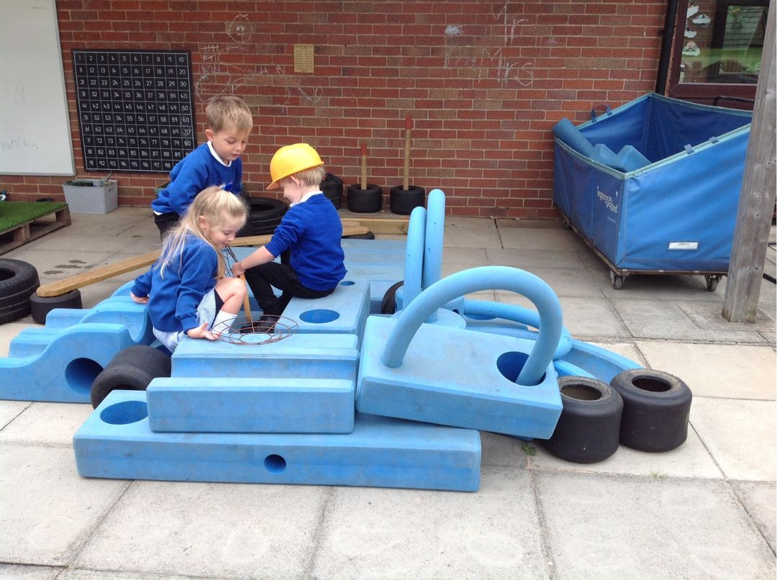
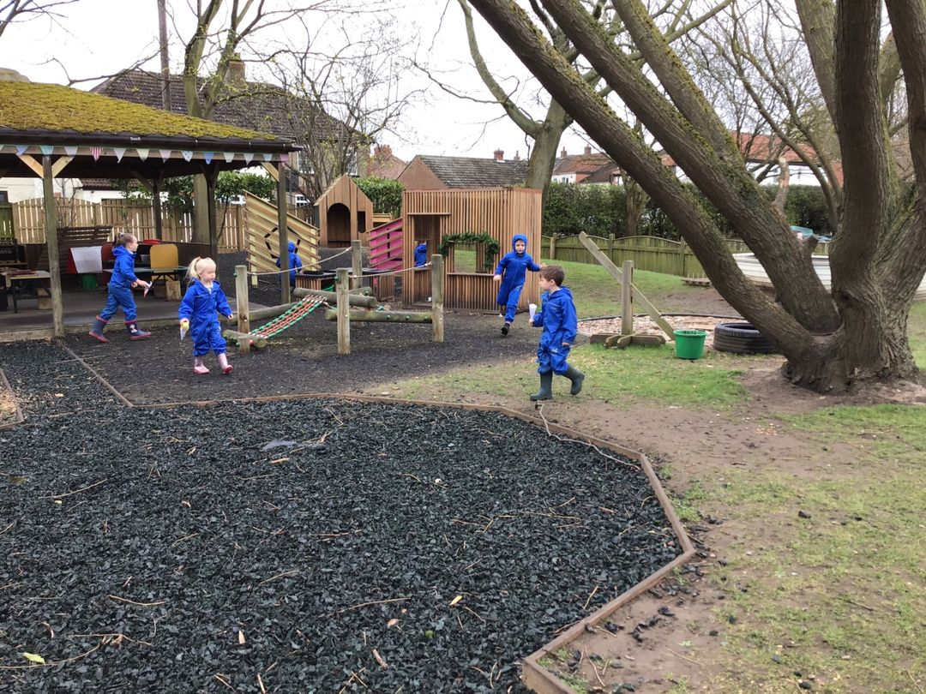
Gross Motor Development
Daily access to outside and indoor provision which includes:
Our own self-contained EYFS outdoor provision accessible all year round
School playground, field, woodland area
Tyre park, climbing frame, climbing trees, balance beams
Large block building materials and large loose parts
Balance bikes, wheeled toys, pushchairs, wheelbarrow
Den-making resources; large sticks, fabric, metal frames
Sand pit, water tray, pebble garden
Drainpipes, funnels, buckets and containers
Dressing up clothes, ironing board, role play house and fort
Nature kitchen, mud kitchen
Parachute, different sized balls, bats, cones, games equipment
Opportunities for forest school throughout the year
Weekly timetabled PE time in the school hall/ outside to teach specific skills
Sequential PE lessons alongside their Year 1 peers in areas of ball skills, running, jumping, dance, athletics, team games, gymnastics
Regular physical warm up games; dancing, yoga, mindfulness activities during the day
Access to slopes, mounds, hills, variety of surfaces
Daily mile running track (whole school ethos)
What does it look like at Cliffe VC Primary School?

Slide 13
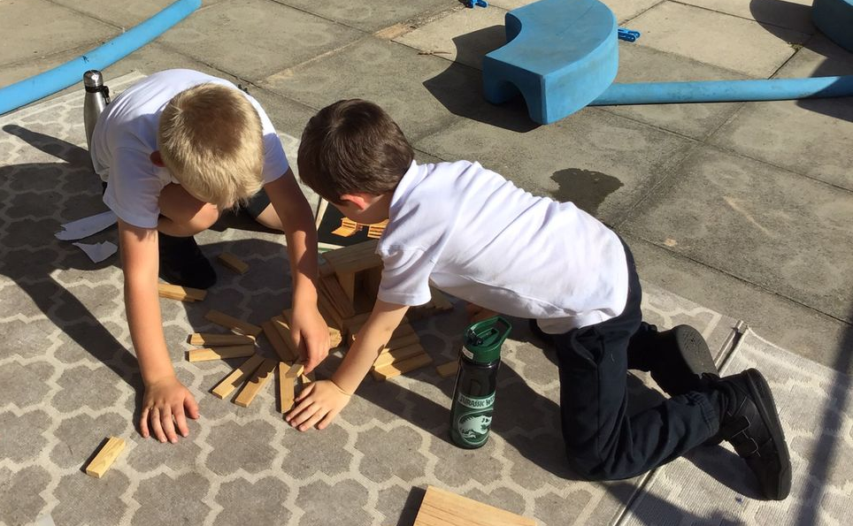
Physical- Fine Motor
Before teaching children the correct pencil grip and posture for writing, or how to use a knife and fork and cut with scissors, check:
that the children have developed their upper arm and shoulder strength sufficiently: they don’t need to move their shoulders as they move their hands and fingers
That they can move and rotate their lower arms and wrists independently
Help children to develop the core strength and stability they need to support their small motor skills
Encourage and model tummy-crawling, crawling on all fours, climbing, pulling themselves up on a rope and hanging on monkey bars.
Offer children frequent activities to develop and further refine their small motor skills, e.g: threading and sewing, woodwork, pouring, tweezers, stirring, dancing with scarves/ ribbons, using spray bottles, dressing and undressing dolls, planting and caring for plants, playing with small world toys, making models for junk materials, construction kits and malleable materials like clay.
Regular review the equipment for children to develop their fine motor skills:
Is it appropriate for the different levels of skills and confidence of the children?
Is it challenging for the most dexterous children?
Continuously check how children are holding pencils for writing, scissors and knives/ forks.
Offer regular, gentle encouragement and feedback
With regular practise, the physical skills children need to eat with a knife and fork, and develop an efficient handwriting style will become increasingly automatic.
Encourage children to draw freely
Engage children in structured activities: guide them in what to draw, write or copy
Teach and model correct letter formation
Continuously check the process of children’s handwriting (pencil grip and letter formation) and provide help/ guidance when needed
Plan for regular repetition so that correct letter formation becomes automatic, efficient and fluent over time
Physical
ELG: Fine Motor Skills
Children at the expected level of development will:
Hold a pencil effectively in preparation for fluent writing- using the tripod grip in almost all cases;
Use a range of small tools, including scissors, paint brushes and cutlery;
Begin to show accuracy and care when drawing.

Slide 14
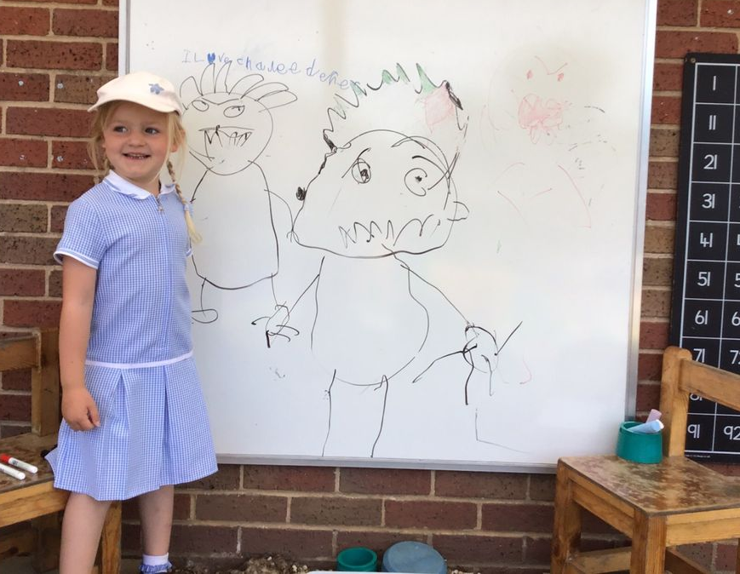
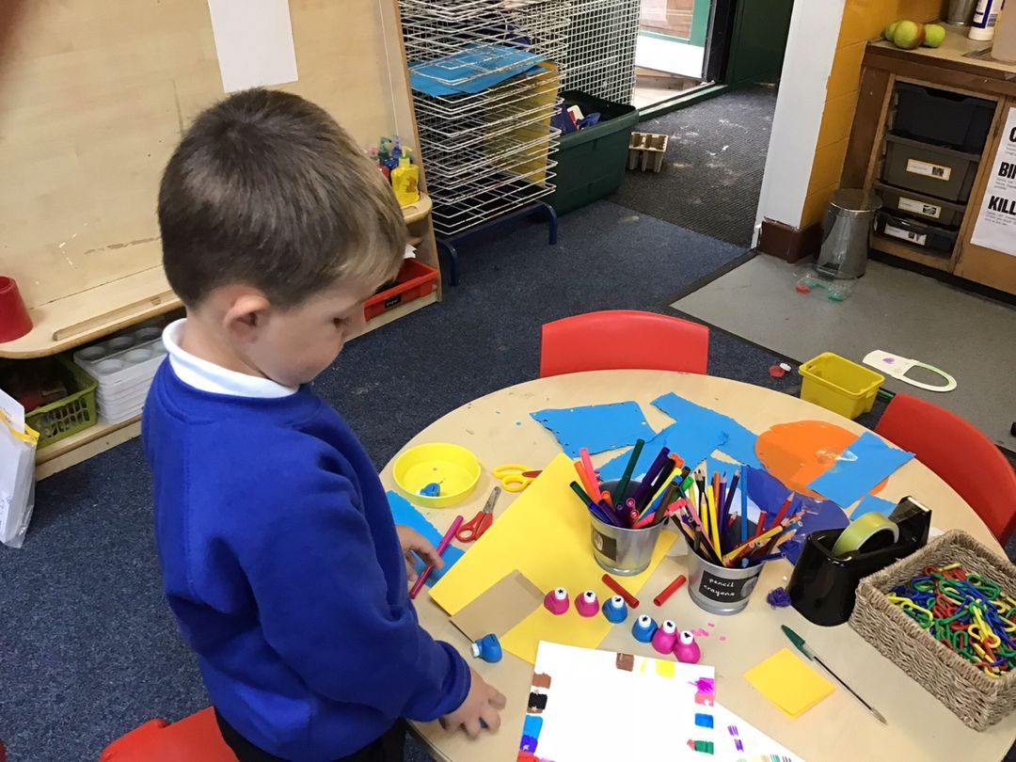
Fine Motor Development
Daily fine motor activities planned into provision- e.g. pegs, small world, pipe cleaner threading, beads, colouring, jigsaws, buttons, dressing dolls, construction kits, playdough, water/sand play, junk modelling, collaging, etc.
Use of sensory resources for mark-making in a variety of ways such as: shaving foam, playdough, paint, printing, mud writing, making patterns with string/ pasta/ loose parts, squishy bags, salt/ glitter trays etc.
Small loose parts in different areas; transient art area, sand, playdough
Provision of chunky pencils and crayons, chunky chalks for writing on the floor, chalkboard etc
Moving onto slimmer pencils and felt tips when ready
Provision of pencil grips if needed
Provision of left and rght-handed scissors/ modelled support to make snips, cut in a line, cut around a shape, etc
Songs and rhymes used to support formation of numerals and letters
Daily support with knife and fork as children eat
Daily handwriting formation included in phonic lessons with follow up activities in provision
Use of a progression map to monitor pencil control and progress
What does it look like at Cliffe VC Primary School?

Slide 15
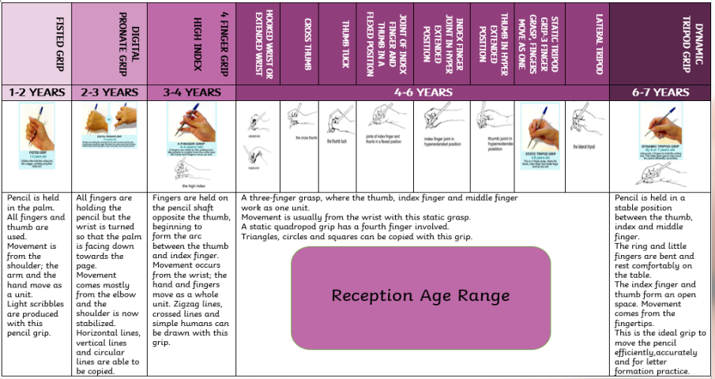
Pencil Grip Progression
By the end of the year, can children hold a pencil effectively in preparation for fluent writing – using a tripod grip in almost all cases? (ELG PD- Fine Motor)

Slide 16
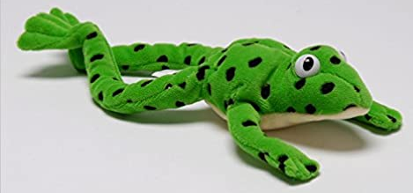
We follow the structure of the Read, Write Inc programme, from Reception, to teach phonics. Read Write Inc. (RWI) is a phonics complete literacy programme which helps all children learn to read fluently and at speed so they can focus on developing their skills in comprehension, vocabulary and spelling. We begin the programme in Reception and will continue teaching RWI to children until they can read fluently. The children begin a short daily phonics session to introduce the letter sounds and opportunities to practise blending, ready for reading. When they are ready, we group children by their reading progress for a daily phonics session. We re-assess children every half-term so we can place them in the group where they’ll make the most progress. We provide extra daily one-to-one sessions for children who need a bit of a boost to keep up. Each week, the children are given the sounds to practise at home and consolidate learning, a teacher-made video is also uploaded to Seesaw, modelling the correct pure sound pronunciation and showing the letter formation phrase for each letter… this is an invaluable tool for informing parents about what has been learnt in school. We ask parents to practise reading these graphemes every time they hear their child read. Our children’s reading journey begins with wordless picture books, as a tool for practising the use of story language, develop vocabulary, understanding of story structures, developing picture cues and fostering an confidence and excitement for reading. As children’s phonic knowledge and skills develop, we introduce phonetically decodable books, which are closely matched to the sounds that the children are familiar with and have been taught in our phonics sessions. We also make weekly use of our school library, to ensure that our children are able to explore a range of fiction and non-fictions texts of their own choosing, enjoying them with parents at home. Near the end of Year 1, all children take part in a statutory Phonics Screening Check to assess whether they have met the ‘expected’ level for reading using their phonics. This check involves the children reading 40 words (some real and some ‘nonsense’ words) using the sounds they have learned. Parents are informed of the results and plans put in place for further support for any children who do not meet the threshold, ready for the re-check at the end of Year 2.
Teaching of Phonics

Slide 17
Literacy- Writing
Writing involves transcription (spelling and handwriting) and composition (articulating ideas and structuring them in speech, before writing)
All writing stages are valued and children’s progress is recorded using our progression map. Children are supported with their gross motor skills and shoulder/ arm strength, if they are not ready to write.
Alongside fine motor activities to strengthen hand grip, we provide:
Daily support to write their name using a variety of tools and resources
Planned, sequenced phonics lessons which begin to incorporate handwriting
Use of rhymes, letter families and handwriting patterns to support letter formation
Frequent shared and modelled writing in Literacy lessons
A variety of writing tools in the provision, including crayons, pencils, chalks, felt pens and pastels
White boards, chalkboards, and a variety of paper in provision inside and outside
Phoneme and grapheme mats, literacy displays and alphabet mats available at all times
Word mats for the children to access
Daily phoneme/ grapheme revisit
Meaningful reasons and opportunities for the children to write for a purpose
Child accessible writing areas with clipboards, resources and the opportunity to decide what they would like to write following their interests
Opportunities to say out loud what we want to write, count the words and use their phonics to record their thoughts
Songs and repetition, use of story maps and retelling the story. This enable the children to practise articulating their thoughts before writing.
What does it look like at Cliffe VC Primary School?
Literacy
ELG: Writing
Children at the expected level of development will:
Write recognisable letters, most of which are correctly formed;
Spell words by identifying sounds with a letter or letters;
Write simple phrases and sentences that can be read by others.

Slide 18
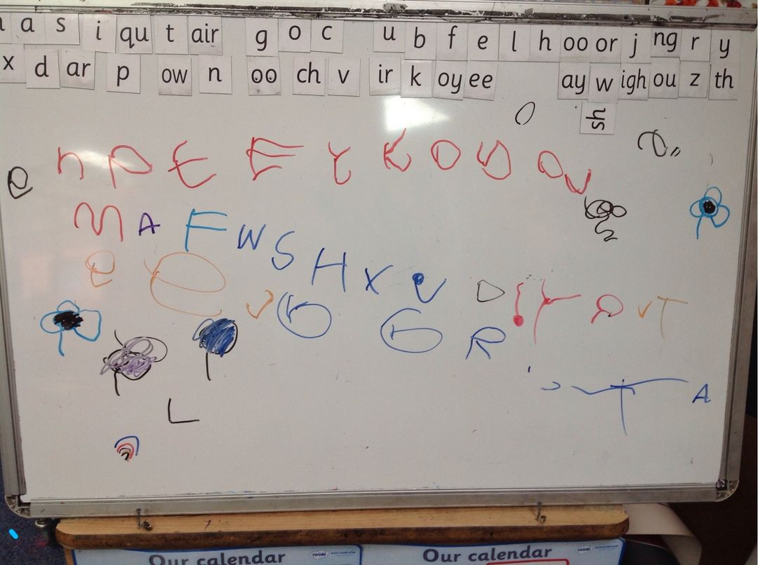
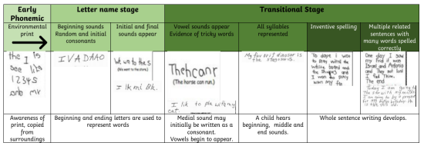
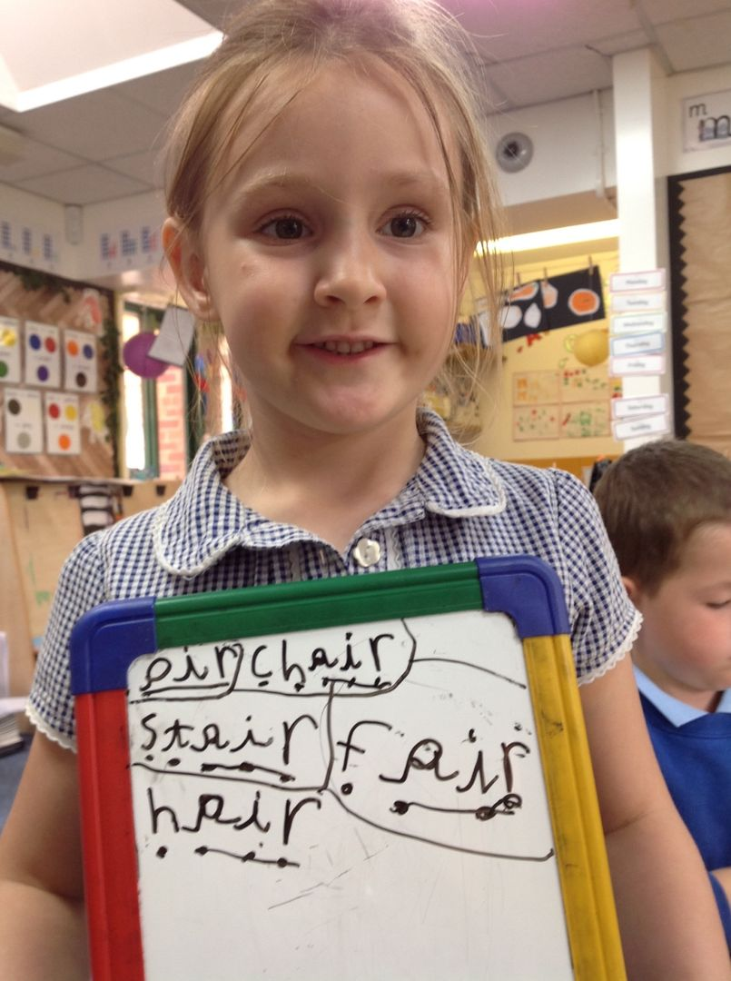
Writing Progression In the EYFS

Slide 19
Literacy
What does it look like at Cliffe VC Primary School?
Regular sharing of books and discussions of children’s ideas and responses (dialogic reading) helps children to develop their early enjoyment and understanding of books
Shared and modelled reading in Literacy lessons
Provision of diverse books, including traditional and modern
Planned, sequenced daily phonics with word and sentence reading opportunities
Use of phonics scheme to teach progressive red words (tricky) and high frequency words
A variety of high quality fiction and non fiction picture books in the provision (not phonetic)
Phonetically decodable reading scheme (RWI Bookbag books) for the children to practise their phonic knowledge
Phoneme and grapheme mats, literacy displays available at all times
Red word games and activities available in provision where appropriate
Meaningful reasons and opportunities for the children to read
Child accessible reading areas and the opportunity to decide what they would like to read, following their interests- books also shared from home
Daily storytime
Year 6 reading buddies to share and model reading
Use of RWI half termly assessments and tracker to assess children’s phonic and reading knowledge
Daily opportunities for blending and segmenting
Comprehension observed during learning
Draw children’s attention to a wide range of examples of print with different functions
Choose books which reflect diversity
Listen to children read aloud, ensuring books are consistent with their developing phonic knowledge. Do not include words that include letter-sound correspondences that children cannot yet read, or exception words that have not yet been taught. Children should not be required to use other strategies to work out words. Make the books available for children to share at home and at school. Avoid asking children to read books at they cannot yet read.
Teach children to read common exception words as they are introduced in RWI.
Teach children to read simple phrases and sentences made up of words with known letter-sound correspondences.
Model how you read and re-read your own writing to check it makes sense.
Regular sharing of books and discussions of children’s ideas and responses (dialogic reading) helps children to develop their early enjoyment and understanding of books
Literacy
ELG: Comprehension
Children at the expected level of development will:
- Demonstrate understanding of what has been read to them by retelling stories and narratives using their own words and recently introduced vocabulary;
- Anticipate - where appropriate – key events in stories
- Use and understand recently introduced vocabulary during discussions about stories, non-fiction, rhymes and poems, and during role play.
ELG: Word Reading
Children at the expected level of development will:
- Say a sound for each letter in the alphabet and at least 10 digraphs;
- Read words consistent with their phonic knowledge by sound-blending;
- Read aloud simple sentences and books that are consistent with their phonic knowledge, including some common exception words.

Slide 20
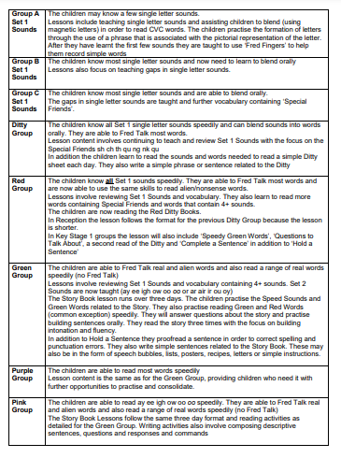
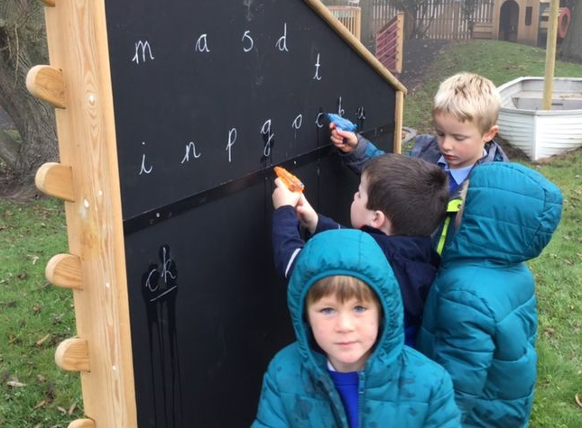
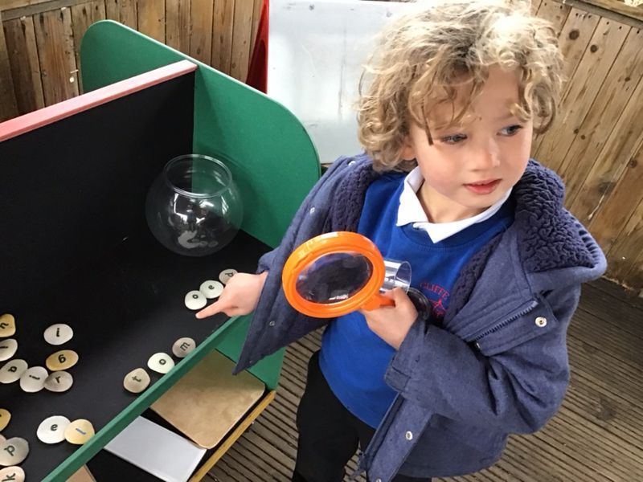
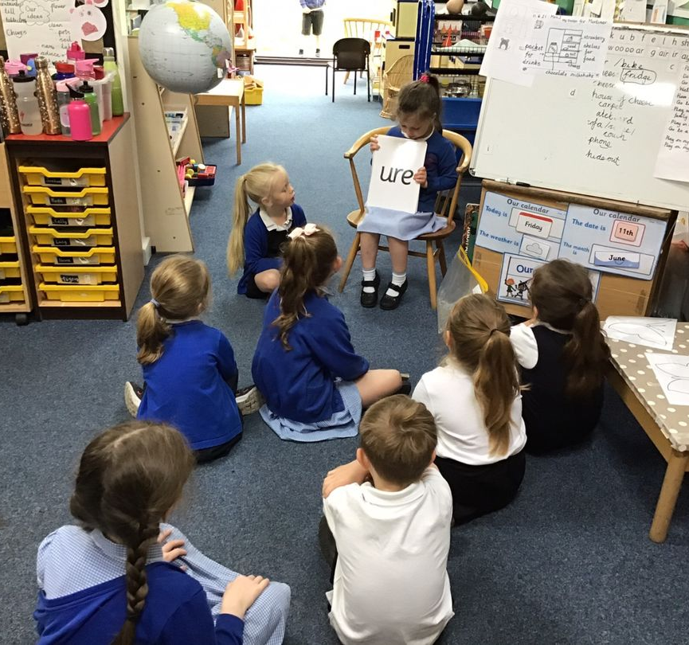
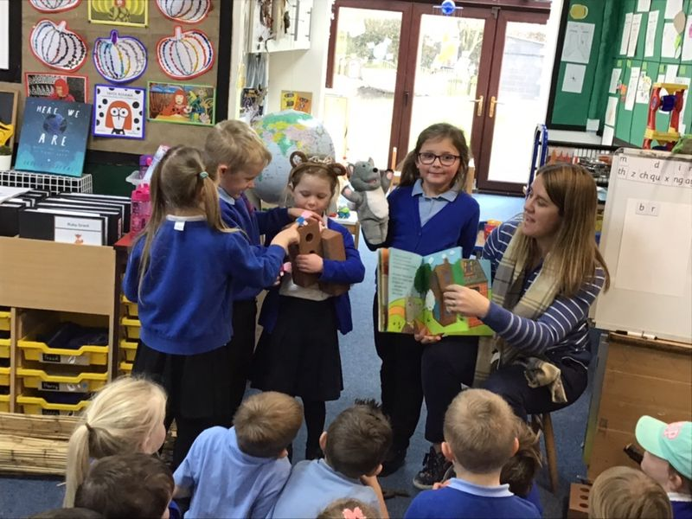
Reading Progression In the EYFS

Slide 21
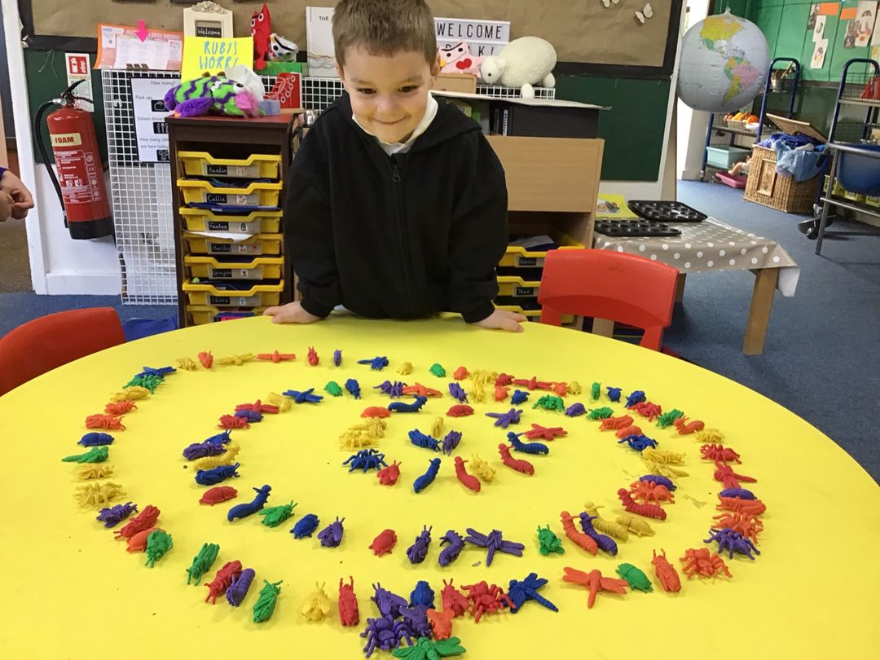
Maths Sense & Number Pattern
What does it look like at Cliffe VC Primary School?
Planned, sequential progressive White Rose maths scheme (linked to the new ELGs)
Use of NCETM and Numberblocks videos and resources for deeper thinking
Numberblocks maths area in provision for children’s interests at all times. Accessible maths displays, number squares, tracks etc.
Daily maths teaching, modelled activities and guided learning
Observations of how children use mathematical thinking in the provision
Use of progression map to build on previous skills and revisit learning
Focus in individual numbers to focus more on subitising, more and less, number bonds and patterns
Shape is taught in a meaningful way alongside the corresponding number- e.g. Triangle is taught when we learn about the number 3, 4 sided shapes when we teach the number 4 etc.
Provision of manipulatives and resources daily, such as Numicon, Numberblocks toys, number frames, counters, number tracks, dot plates etc- see progression of resources
Daily maths songs, rhymes and action rhymes throughout the day
Planned activities which link to interests and extend vocabulary
Mathematical challenges added to provision
High quality story books which talk about our illustrate number/ patterns to make our learning meaningful
Provide good quality constructions/ pattern and building sets
Focus on composition of smaller numbers before moving on
Sustained focus on each number
Assessment through observation/ questioning
Mathematics
ELG: Number
Children at the expected level of development will:
Have a deep understanding of number to 10, including the composition of each number;
Subitise (recognise quantities without counting) up to 5;
Automatically recall (without reference to rhymes, counting or other aids) number bonds up to 5 (including subtraction facts) and some number bonds to 10, including double facts.
ELG: Numerical Patterns
Children at the expected level of development will:
Verbally count beyond 20, recognising the pattern of the counting system;
Compare quantities up to 10 in different contexts, recognising when one quantity is greater than, les than or the same as the other quantity;
Explore and represent patterns within numbers up to 10, including evens and odds, double facts and how quantities can be distributed equally.

Slide 22
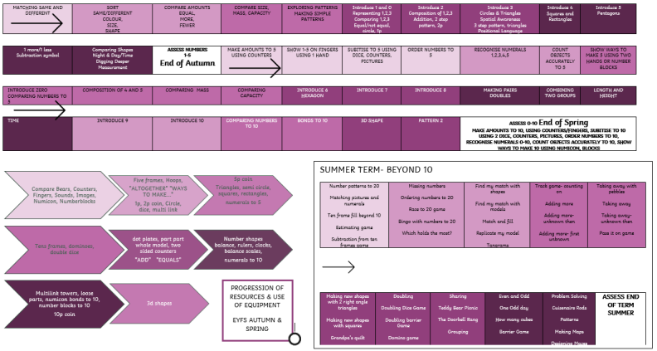
Mathematics Progression in the EYFS

Slide 23
Understanding the World
What does it look like at Cliffe VC Primary School?
Planned, directed learning as well as learning in the environment
Look a seasons and how the environment changes and explore the weather- themes
Seasons shelf display updated to match the current season and stimulate interest
Provide interesting natural environments for children to explore freely outdoors.
Make collections of natural materials to investigate and talk about
Spend time with children talking about photos, memories
Invite different people to visit from a range of occupations and cultures
Show and explain the concepts of growth, change and decay with natural materials. Plant seeds, garden, observe over time. Themes.
Plan and introduce new vocabulary related to the exploration. Encourage children to use it in their discussions, as they care for living things.
Investigate how animals and plants grow and learn about the life cycle of a chick, frog, butterfly
Encourage children to refer to books, wall displays and online resources
Read high quality fiction and non fiction books to support learning
Draw children’s attention to forces e.g how water pushes up when they try to push a plastic boat under it, how they can stretch elastic, snap a twig, but can’t bend a metal rod, magnetic attraction and repulsion
Investigation station in the classroom with resources for children to explore and experiment with
Plan and introduce new vocabulary related to the exploration, and encourage children to use it. Talk about natural and man-made objects.
Regular outdoor learning/ forest school sessions throughout the school year
Provide opportunities to change materials from one state to another e.g. cooking – combining different ingredients, and then cooling or heating them, melting – leave ice cubes out in the sun, see what happens when you shake salt onto them.
Explore how different materials sink and float
Explore how you can shine light through some materials, but not others. Investigate shadows.
Teach specific history themed topics alongside the year 1 children
Understanding the World (History/ Science)
ELG: Past and Present
Children at the expected level of development will:
Talk about the lives of the people around them and their roles in society;
Know some similarities and differences between things in the past and now, drawing on their experiences and what has been read in class;
Understand the past through settings, characters and events encountered in books read in class and storytelling.
ELG: The Natural World
Children at the expected level of development will:
Explore the natural world around them, making observations and drawing pictures of animals and plants;
Know some similarities and differences between the natural world around them and contrasting environments, drawing on their experiences and what has been read in class;
Understand some important processes and changes in the natural world around them, including the seasons and changing states of matter.

Slide 24
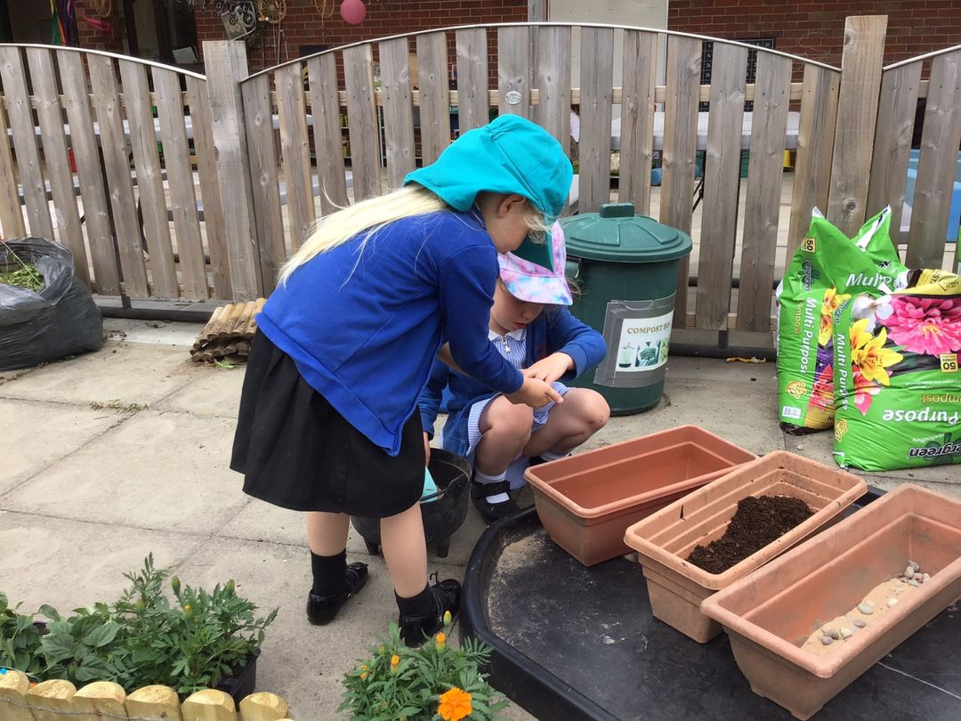
Understanding the World
What does it look like at Cliffe VC Primary School?
As the children are in a mixed age class, we teach their older peers Geography and RE over the year. Therefore, the EYFS children are involved in some of these themes and topics
We also follow the children’s interests in these areas and provide a variety of real-life objects, videos, photographs and, where possible, visits/ visitors. We ensure that resources reflect the diversity of life in modern Britain.
Encourage children to talk about the differences they notice between people, whilst also drawing their attention to similarities between different families and communities
Celebrate and value cultural, religious and community events and experiences. Learn about different celebrations around the world such as Diwali (Hindu), Bonfire Night, Luna New Year (Chinese), Mother’s Day, St David’s Day, World Book Day, Holi (Festival of Colour) Hindu, Easter, Hannukah (Jewish), Rememberance Day
Teach children that there are different countries in the world and talk about the differences they have experienced or seen in photos.
Learn about the community and the school grounds- use simple maps/ Google Earth
Take part in some of the school assemblies
Learn about what Christians believe and listen to Christian stories
Listen to Muslin stories and compare it to the Christian stories
Learn about other countries and regions in our themes.
Understanding the World (Geography/Religion)
ELG: Past and Present
Children at the expected level of development will:
Describe their immediate environment using knowledge from observation, discussion, stories, non-fiction texts and maps;
Know some similarities and differences between different religious and cultural communities in this country, drawing on their experiences and what has been read in class;
Explain some similarities and differences between different religious and cultural communities in this country, drawing on their experiences and what has been read in class;
Explain some similarities and differences between life in this country and life in other countries, drawing on knowledge from stores, non-fiction texts and – when appropriate – maps.

Slide 25
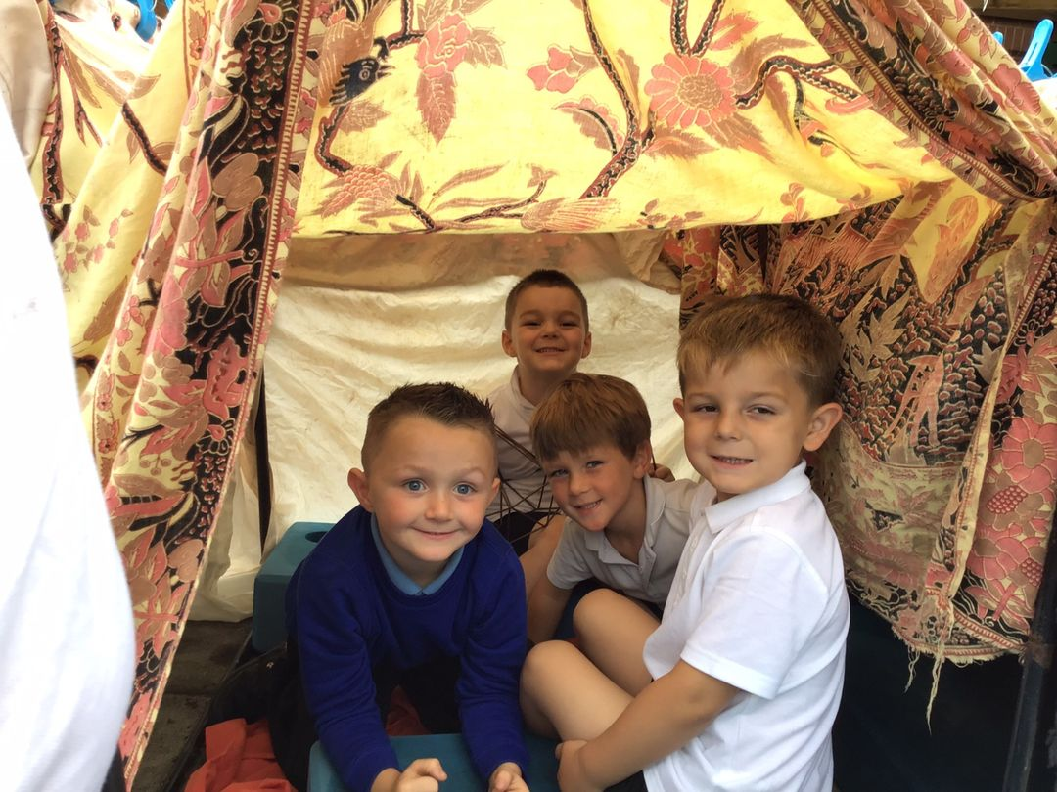
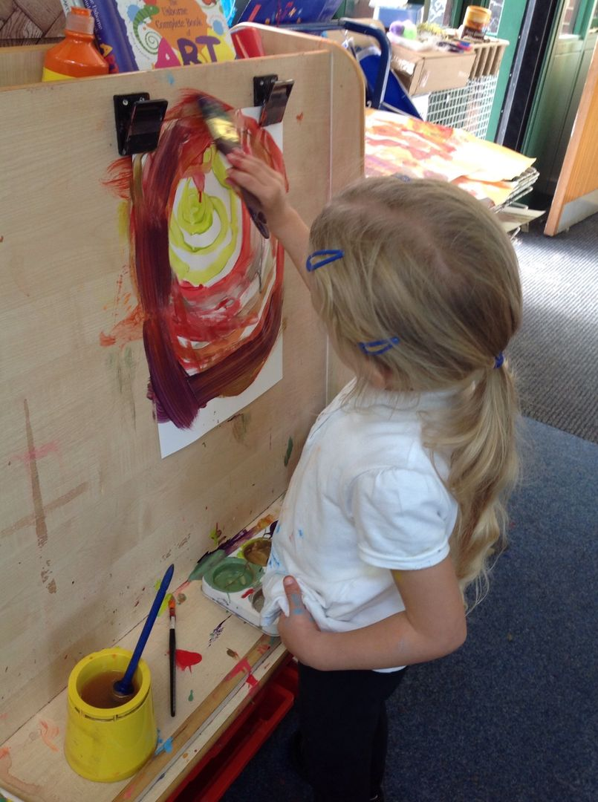
Expressive Art & Design
What does it look like at Cliffe VC Primary School?
Teach children to develop their colour-mixing techniques to enable them to match the colours they see and want to represent, with step-by-step guidance when appropriate. Teach children the primary colours and share artist’s work to discuss.
Provide opportunities to work together to develop and realise creative ideas.
Provide children with a range of materials for children to construct with. Encourage them to think about and discuss what they want to make. Discuss problems and how they might be solved as they arise. Reflect with children on how they have achieved their aims.
Transient art area for children to see that art can be flexible and manipulated. Encourage children to take photos of their creations using the iPads.
Use colour and pattern to express their mood.
Teach children different techniques for joining materials, such as how to use sticky tape and glue
Provide a range of materials and tools, and teach them to use them with care and precision. Promote independence, taking care not to introduce too many new things at once.
Encourage children to notice features in the natural world. Help them to define colours, shapes, textures and smells in their own words. Discuss children’s responses to what they see.
Give children an insight into new musical worlds. Introduce them to different kinds of music from across the globe, including traditional and folk music from Britain.
Invite musicians in to play music to the children, and talk about it.
Encourage children to listen attentively to music and also to use music to express themselves through dance or art. Discuss changes/ patterns as music develops.
Sing in a group or on their own, increasingly matching the pitch and following the melody.
Daily singing session, covering a range of songs, including nursery rhymes.
Use of songs for different transitions during the day, such as lunch/home time. Use of songs in other areas of learning, e.g maths.
Encourage children to keep to a steady beat, this may be whilst singing and tapping their knees, dancing to music, or making their own music with instruments and sound makers.
Play movement and listening games that use different sounds for different movements, Model how to tap rhythms to accompany words.
Play music with a pulse for children to move in time with and encourage them to respond. Encourage children to create their own music.
Regular opportunities to replicate choreographed dances using GoNoodle and Kidzbop online resources
Visit to the theatre to see a pantomime
Provide related costumes and props for children to incorporate into their pretend play.
Provide a wide range of props for play which encourage imagination
Take part the Nativity performance and class assembly performance.
Expressive Art and Design
ELG: Creating with Materials
Children at the expected level of development will:
Safely use and explore a variety of materials, tools and techniques, experimenting with colour, design, texture, form and function;
Share their creations, explaining the process they have used;
Make use of props and materials when role playing characters in narratives and stories.
ELG: Being Imaginative and Expressive
Children at the expected level of development will:
Invent, adapt and recount narratives and stories with peers and their teacher;
Sing a range of well-known nursery rhymes and songs; Perform songs, rhymes, poems and stories with others, and - when appropriate – try to move in time with music.

Slide 26
Working With Parents
Community Links and the Wider World
Over the year, we arrange visits from members of the local community to support our topic work. We also arrange trips within the local community, for example visiting the library, the village amenities or the local church.
Film clips, non-fiction texts and artefacts are also used to introduce new concepts in real-life contexts. We aim to develop the children’s awareness of other cultures by exploring different countries and celebrations through our RE lessons.
Working in Partnership with Parents
We value the contribution that our parents and carers make to their child’s learning and take every opportunity for parents to complete an ‘Marvellous Me’ document as children start school and give parents online access to Seesaw. We encourage parents to add observations and contributions from home so that we can gain a wider view of their child. In the Autumn and Spring terms, we hold parents’ consultations and in the Summer term, we send home detailed reports.
The children take reading and library books home to share, along with a home/school journal which parents’ carers are asked to write in every time they read with their children also make and upload videos to Seesaw alongside phonics learning in school to help parents in supporting their child at home. Seesaw is used to record children’s ‘wow’ moments in the classroom and share with parents, as well as daily correspondence and for parents to ensure that they are up to date with current learning and activities taking place. We also send out a weekly overview of learning as part of the whole school newsletter which is emailed out to parents each week.
We offer a regular ‘Stay and Play’ session for parents to enable them to feel part of their child’s school life, have a first hand experience of the classrooms, resources and activities, and share learning with their own child in the setting.

Slide 27
Observation and Assessment In Reception, the team use a range of strategies to gather information about the children’s learning and development. We use observations as our main form of assessment, and ‘wow’ moments are recorded in a learning journal online called ‘Seesaw’. Seesaw is a secure online journal which builds on children’s experiences during their time with us. It enables parents to view work from school and see how their child is doing online. Parents can share pictures/ videos with school in order to inform our planning and assessments of children. Seesaw information is stored on a secure server which is monitored closely, and the software can be accessed from a desktop PC or via smartphone app for Android and Apple devices. Keeping children safe online is extremely important to us at Cliffe VC Primary School, therefore we ask parents to sign an agreement and other information to show that they understand and agree with our guidelines whilst using Seesaw. The children’s learning is monitored and sometimes observed through photographs, notes and videos. Some literacy or maths may be recorded in files or on display in the classroom. Staff constantly use their professional judgement to decide what a child is achieving and what they need to do next. The staff watch the children interacting through their play and learning, we model and guide to support the children and assess the children using the non-statutory framework ‘Development Matters 2021’. Observations are completed individually and in groups by all team members.
Assessment
During the first few weeks of the Autumn term, the class teacher completes a baseline assessment on each child to decide which band of ‘Development Matters’ they are working within in each area of the curriculum. We check the preceding age band (3-4 years) and record any gaps that the children my have and monitor who is not on track for these specific skills. This allows learning opportunities to be pitched appropriately and as well as providing a baseline of the children’s attainment. This information is closely monitored to ensure that all children are making good progress.
Towards the end of each half term, the class teacher uses Seesaw and teacher assessments to record how well the children are progressing in each area of the curriculum and which areas we need to work on next. Tracking progress half termly enables staff to monitor the progress the children are making in all areas and check the coverage of all areas of the curriculum. In the summer term, the class teacher reviews the ELGs in the EYFS Profile to decide whether each child is working at the expected levels or below. Judgements against the ELGs are based on observations, evidence in files and discussions with all staff involved with the child. The results of the Profile are shared with parents and carers vis a report. The EYFS profile results are reported to the local authority, who monitor and moderate the judgements made.

Slide 28
Daily story time
Sharing books throughout provision
Extend children’s vocabulary, explaining unfamiliar words and concepts
High-quality picture books
Shared book reading
Core books, songs and rhymes
Communication & Language
Small world play, pretend play & outdoor provision
Correcting grammar, modelling language, expanding phrases
Promote active listening- carpet time, circle time
Speaking in complete sentences, questioning, narrating
Book corner, literacy displays, books through provision
Routine songs, rhymes, poems, Storytelling language

Slide 29
Physical challenge resources provided, change equipment and resources regularly
Putting own belongings away, tidying the classroom, setting up snacktime
Model positive play and cooperation
Clear ‘safe’ rule
Model safe play
Personal, Social & Emotional
Free choice play provision inside and outside as well as directed activities
Clear boundaries and school rules
Finding out about families and home life, Seesaw, Home/ school journals
Circle time, positive behaviour reinforcement, strategies for staying calm
Good hygiene practice-washing hands, toilet hygiene etc.
High expectations of good manners
Consistent modelling

Slide 30
Develop gross motor skills with easels, large blackboards, chalks on the ground
Choice of mark making materials, variety of resources
Climbing frame and trees, pedal toys, balance beams, stepping stones
Movement play, Sand pit, water play, mud kitchen, nature kitchen, playdough
Physical
Outdoor learning, PE lessons- dance, agility, team games
Provision and modelling of one handed tools- scissors, tweezers, tools, pegs etc
Independent dressing, washing and toileting encouraged
Healthy snacks, consistent handwashing
Fine motor/ handwriting skills refined through provision
Model-making, construction, hoops, parachute, balls, blocks

Slide 31
Wide examples of print, displays, books, resources inside and outside
Daily rhymes and songs
Daily phonics lessons
Daily storytime and questions
Diverse range of high quality texts
Provision of clipboard, notebooks, whiteboards, writing area
Literacy
Range of mark making tools and paper resources to choose from
Phonics display, key word and phonic mats
Phonic reading books for home and school, linked to phonic lessons
Read Write |Inc phonics teaching; whole class, groups and individual
Modelled and shared writing
Weekly reading with teacher
Phonics activities, adult-led writing tasks, handwriting sessions (when appropriate)

Slide 32
Opportunities for exploring maths concepts in other areas of learning
Maths corner, wide selection of maths resources in provision
White Rose planning based on progressive steps through the number system
Numberblock videos and resources (NCETM)
Mathematics
Shape and pattern teaching linked to lessons on number
Free play with blocks, shapes, multilink, tens frames, counters etc
Obstacle courses and hunts using positional language
Provide a variety of patterns (including ones from different cultures)
Number story books, board games, jigsaws
Directed maths teaching with challenges and questioning

Slide 33
Natural environment provision, shells, mud, natural objects, logs etc
Photos of children in the past, discuss memories
Stories including past/ present
People who help us visits – fire service, nurse etc.
Animals & Minibeasts
Explore different equipment, wind up toys, Beebots etc
Understanding the World
Discuss forces outside, water, twigs, snapping, push & pull
Floating & Sinking, Shadows & the seasons, Planting & Growing, Ice & Heat
Maps, books from around the world, non-fiction books. Learn about contrasting areas
Explore homes, schools, a local building, area or transport from the past
Manmade a natural materials.
The weather.
Our senses
Special celebrations
RE directed teaching

Slide 34
Role play areas
Small world play Dressing up, props, puppets
Cutting and sticking resources in provision; glue, scissors, tape, boxes, collage materials
Free choice creating provision & directed art lessons on specific artists and skills
Variety of music and songs from different cultures
Range of instruments
Expressive Art & Design
Discuss forces outside, water, twigs, snapping, push & pull
Opportunities to watch performances: music, pantomime etc
Direct music teaching, call and response, songs and rhyme
Focus on directed art skill teaching- process not end product
Daily nursery rhymes, action songs
Sculpture, clay, collage, junk modelling, textiles opportunities

Slide 35
Provide different resources to increase their experiences
Provide a well ordered environment to increase independence
Organise space and resources for good collaboration with peers
Encourage children’s interests and provide non-fiction books to help them explore
Characteristics of Effective Learning
Offer support and guidance so children can explore through trial and error
High quality, open ended resources so children can play freely
Help children to reflect on their learning- Seesaw
Make time and space for children to explore freely each day
Support children to challenge themselves and assess possible risks
Enable the children to take ownership of their learning, e.g. patches

